Slide 1
Tea-Mates

Slide 2
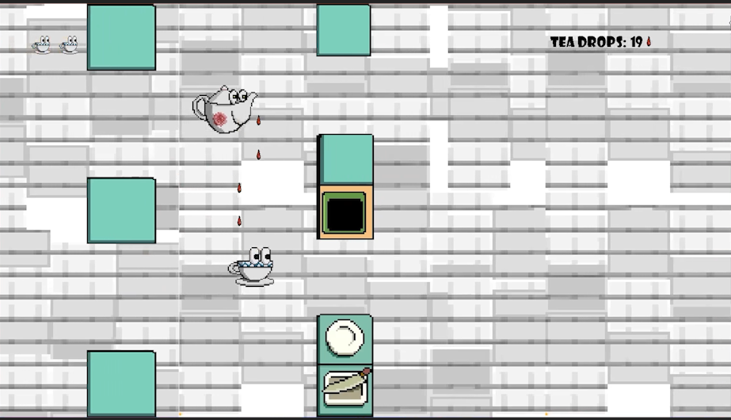


What is Tea-Mates?
Hand-painted pixel art game assets
Two player co-op
A challenging obstacle course
Delivery and Refilling system

Slide 3




Concept Art
Please enjoy the hard work of our art team

Slide 4
Come By And Play Some Time

